Slide 1





Lesson 3:Catch the Bus

Slide 2
Slide

Slide 3
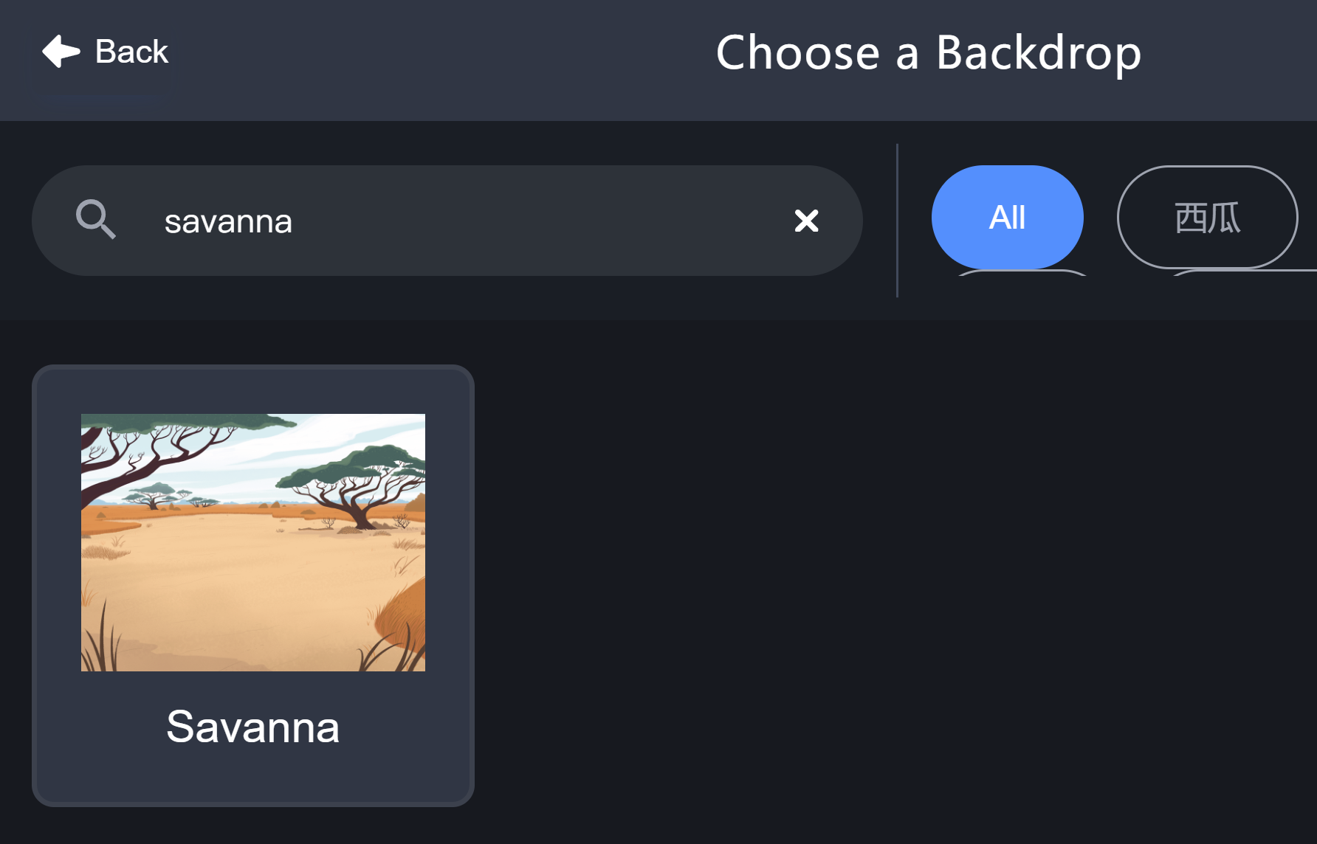
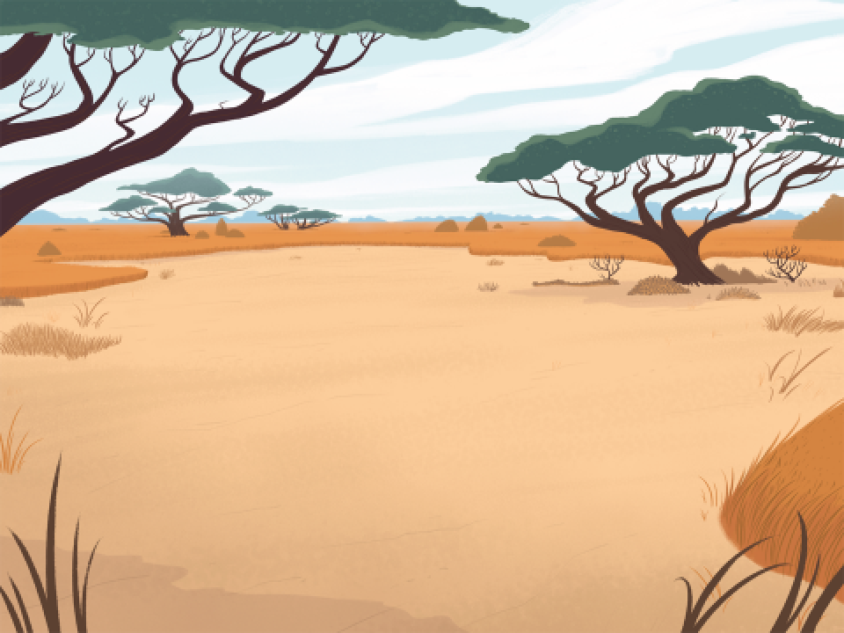
Backdrop - Savanna

Slide 4

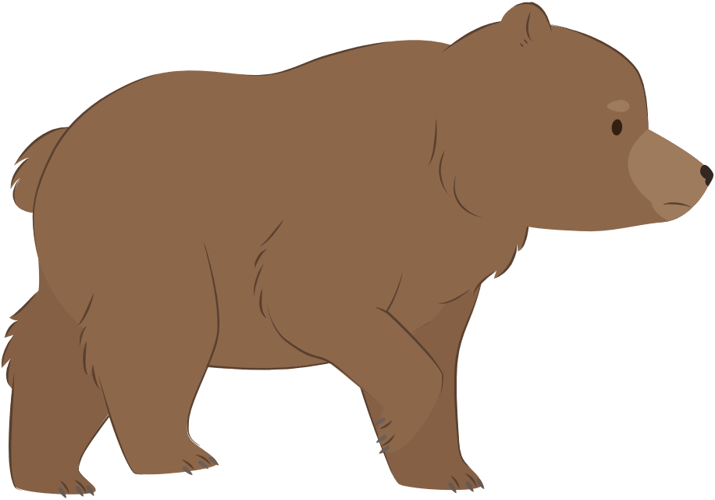

Animal Sprites
Bear
Parrot
Hedgehog

Slide 5
Change Sprite Size
size: 50
size: 100
size: 200

Slide 6
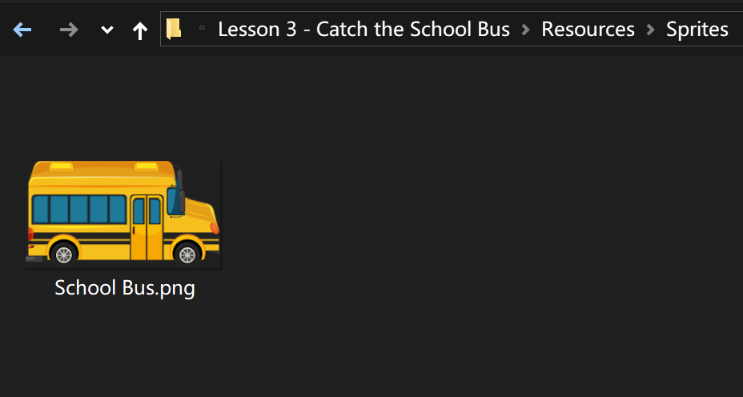

School Bus

Slide 7
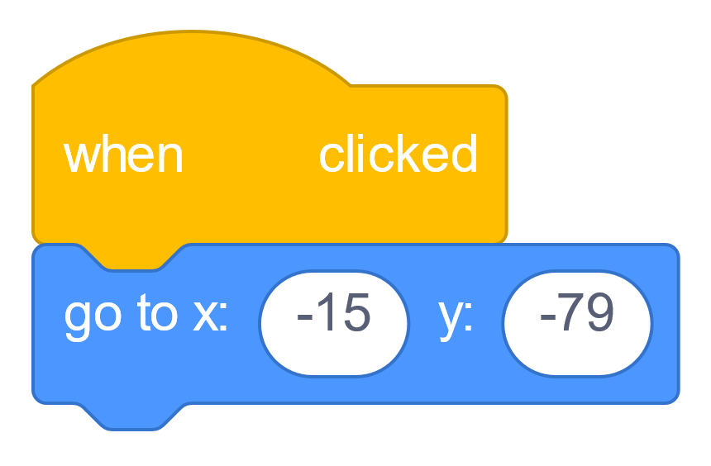
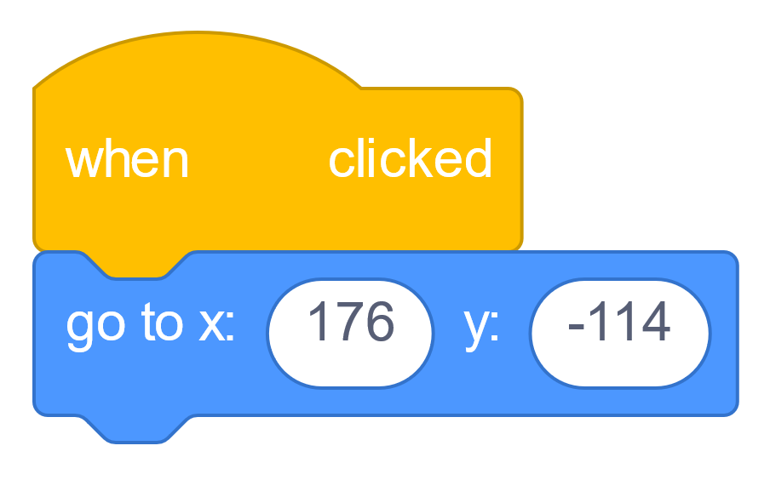

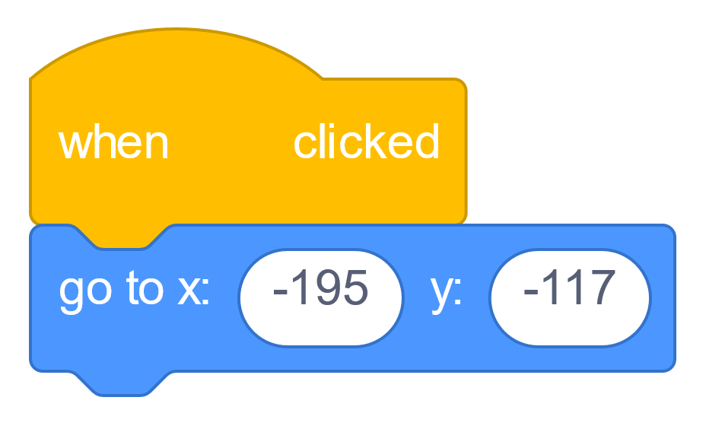
Get in Place!

Slide 8
Not Facing the Bus!

Slide 9
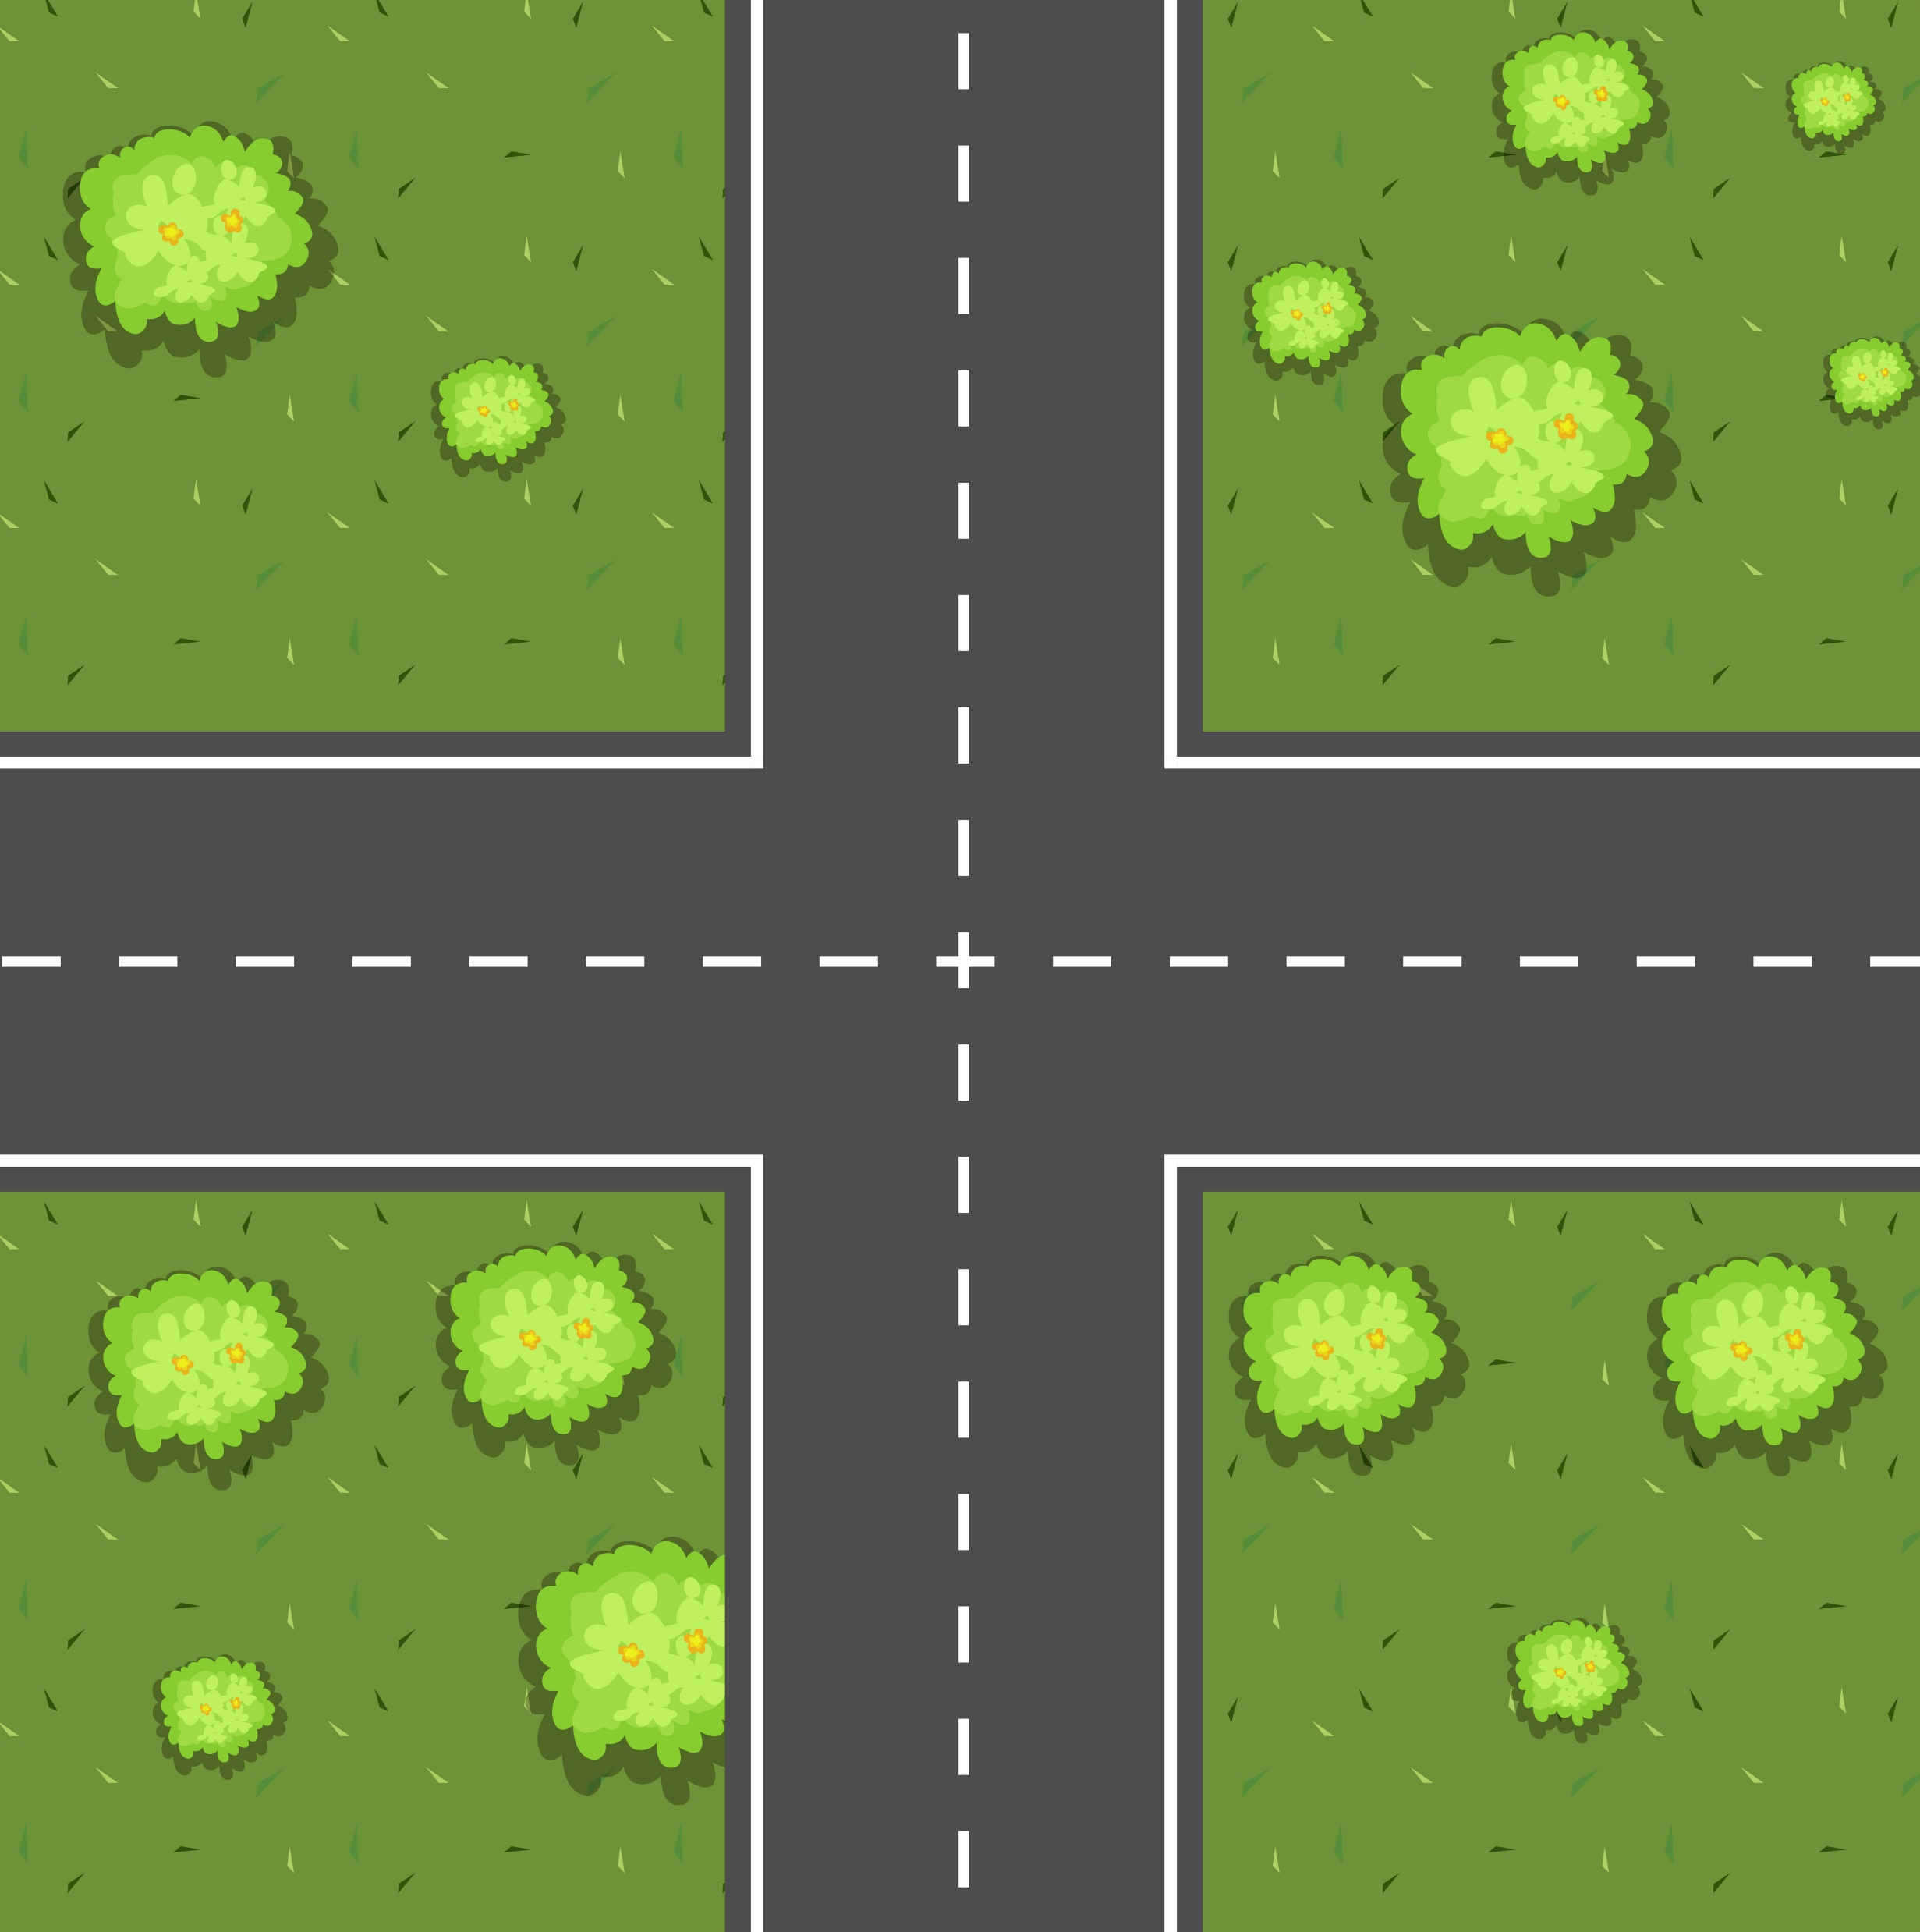

Directions
North
West
East
South

Slide 10
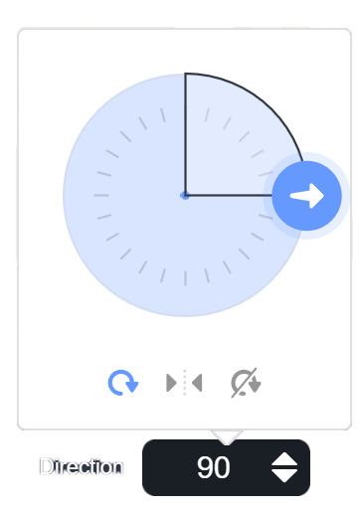
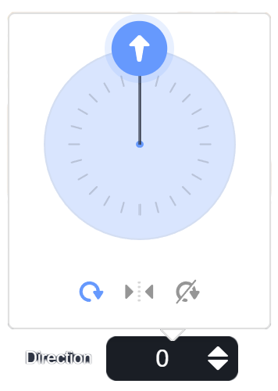
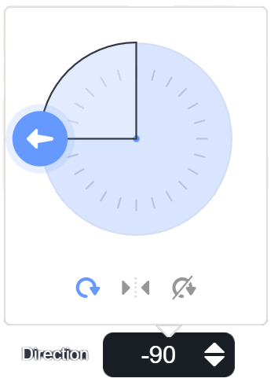
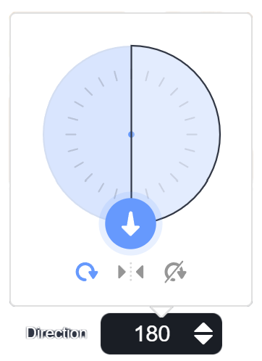
Direction Clock

Slide 11
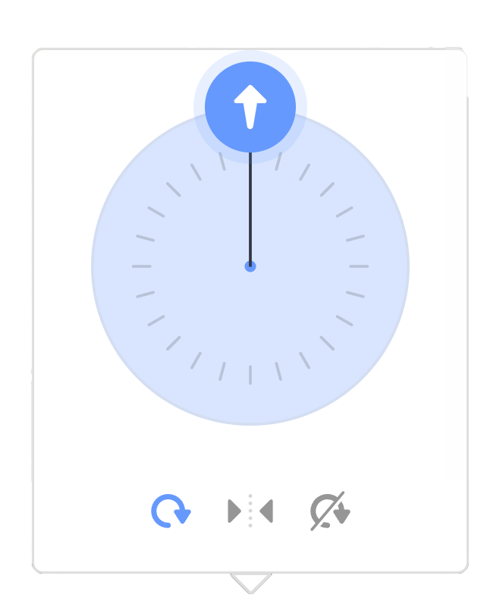

Direction Clock
-1°
0°
-179°
180°

Slide 12
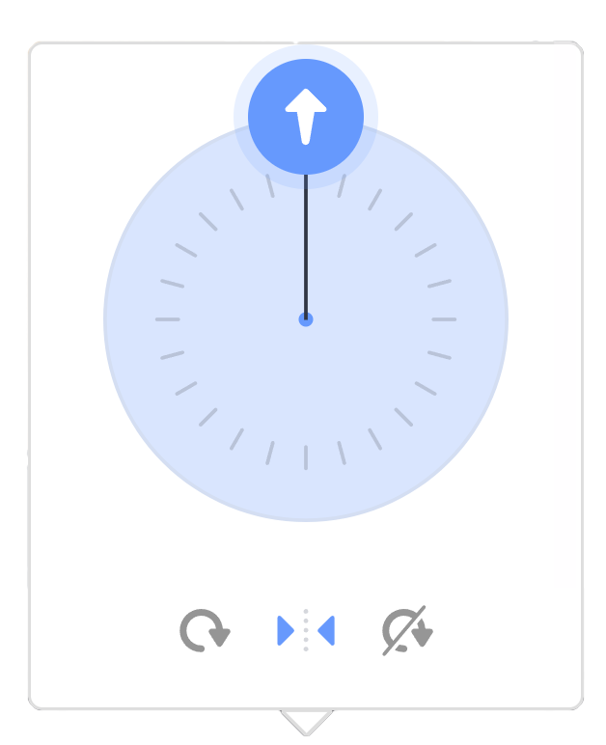
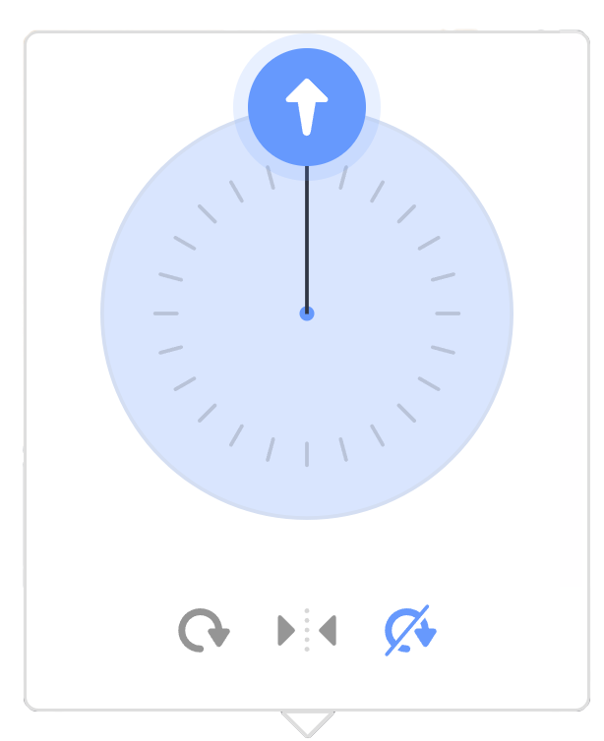
Rotation Style
All Around
Left/Right
Do not Rotate

Slide 13
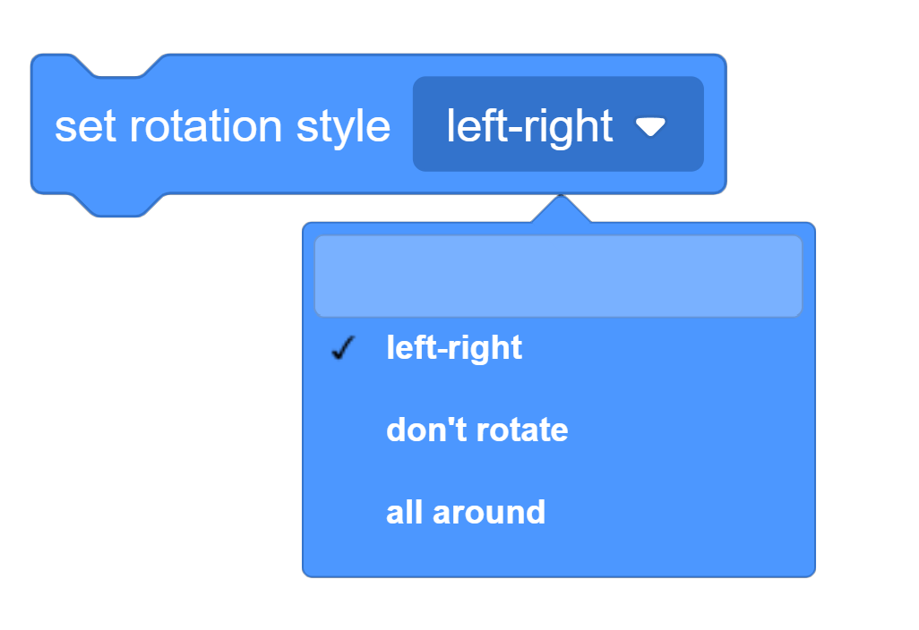
Set Rotation Style

Slide 14

Set Direction

Slide 15
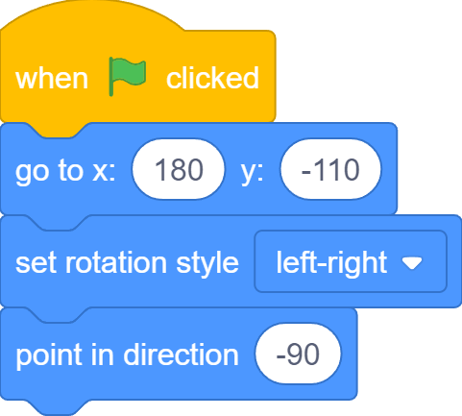
Face the Bus

Slide 16
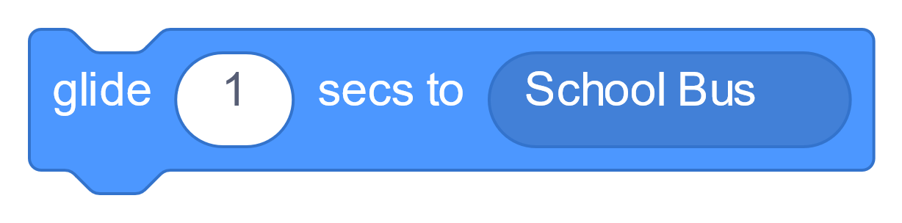
Glide to the Bus

Slide 17
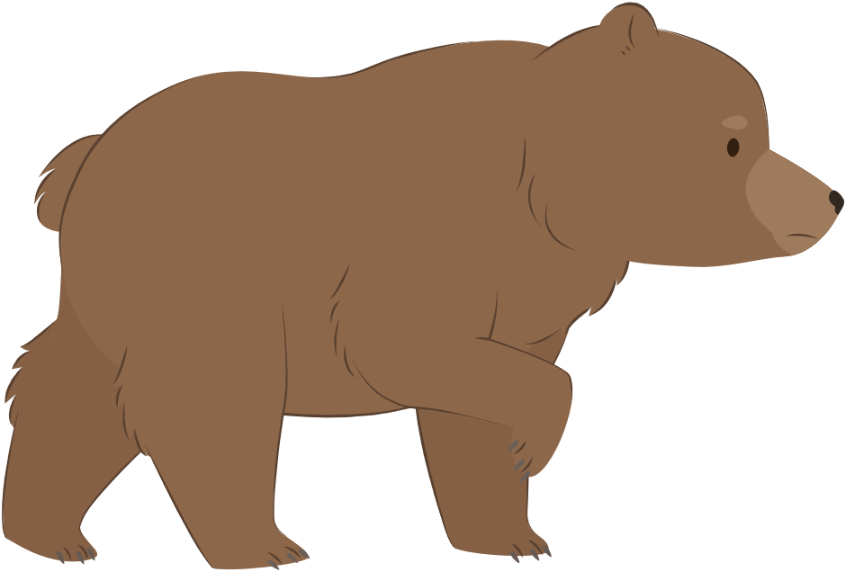
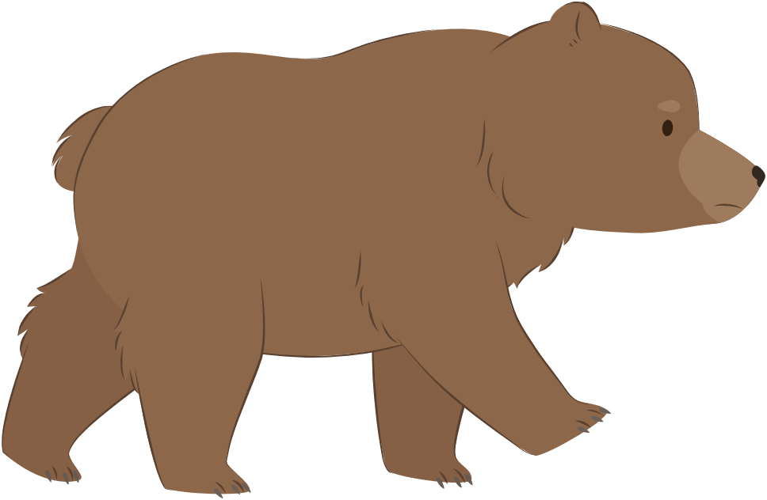
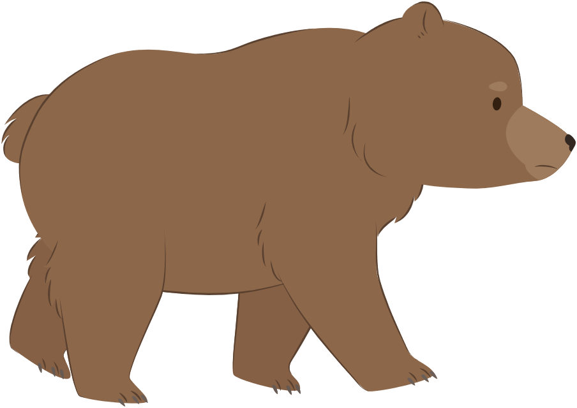
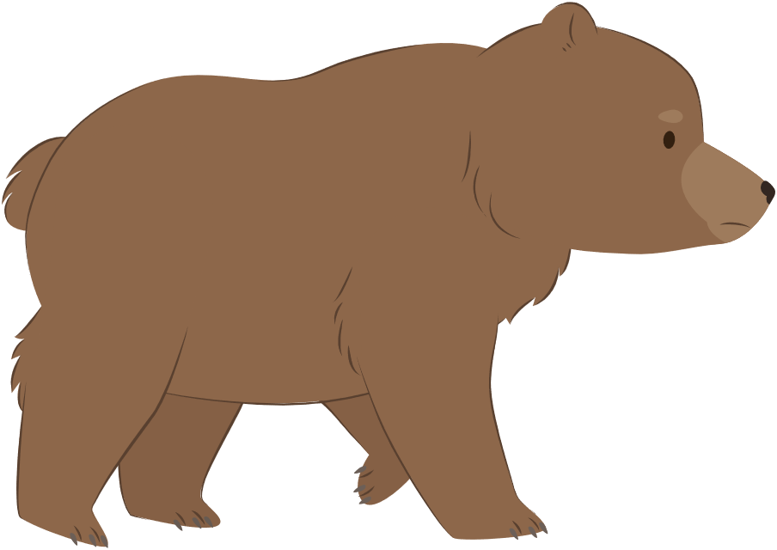
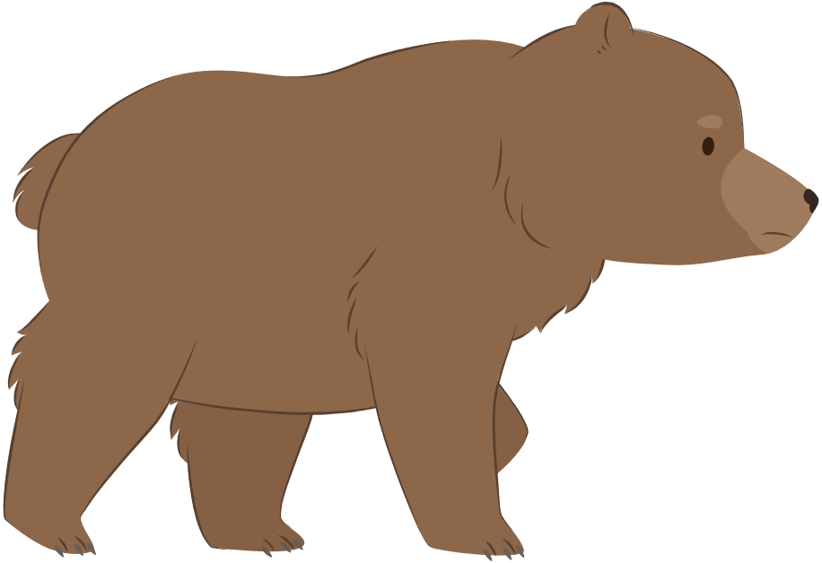
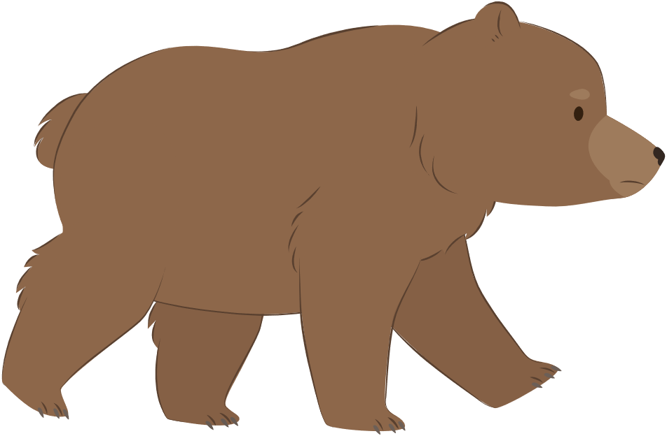
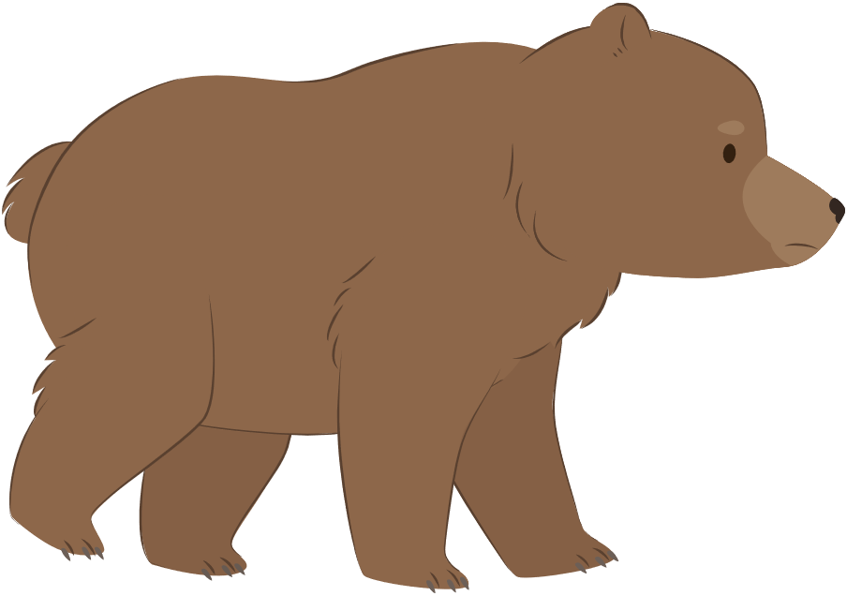
How bear Walks
bear-walk-a
bear-walk-b
bear-walk-c
bear-walk-d
bear-walk-e
bear-walk-f
bear-walk-g
bear-walk-h

Slide 18
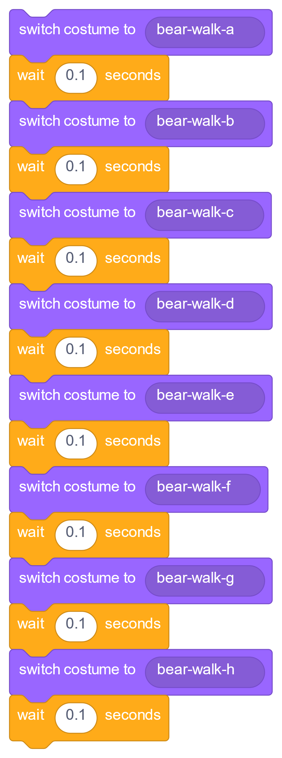
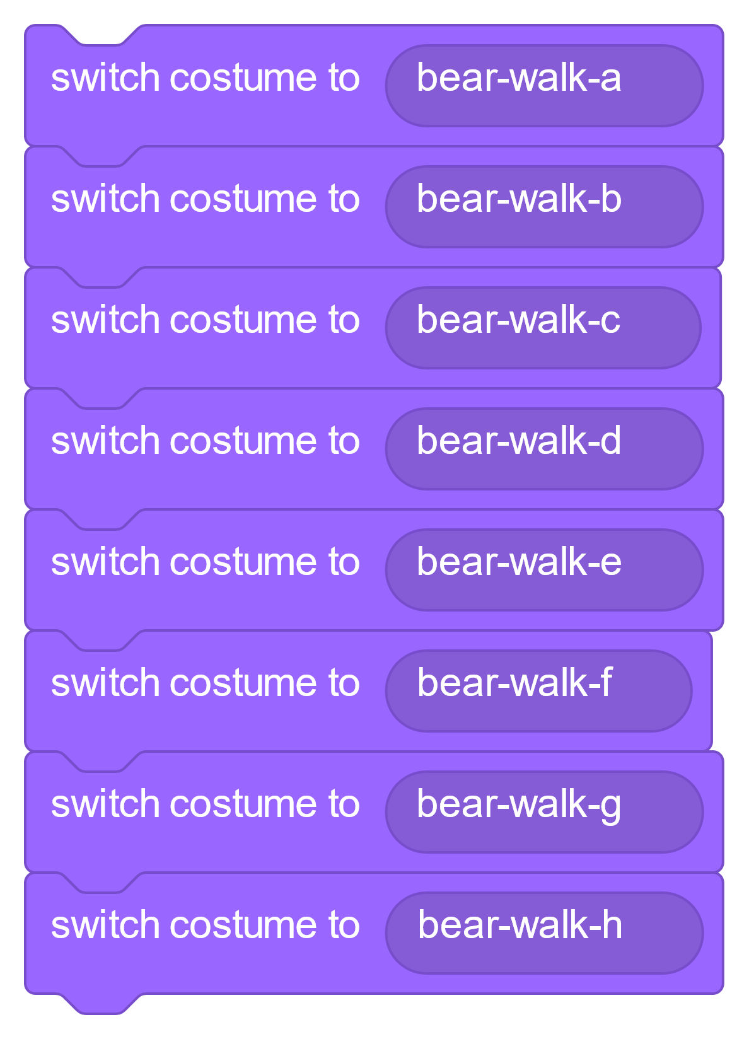
Switch Costumes

Slide 19
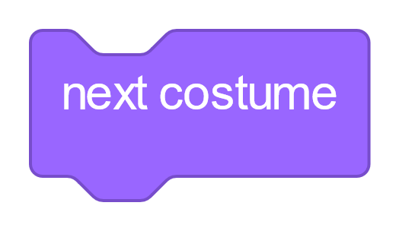
Next Costume
bear-walk-a
bear-walk-b
bear-walk-c
bear-walk-d
bear-walk-h
bear-walk-g
bear-walk-f
bear-walk-e

Slide 20
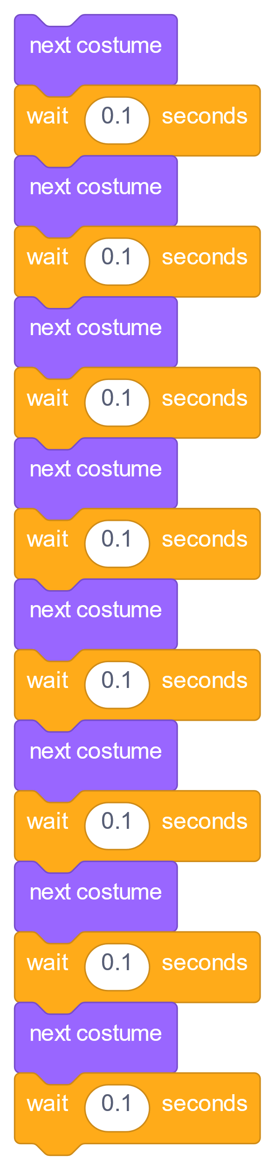
Switch Costumes

Slide 21
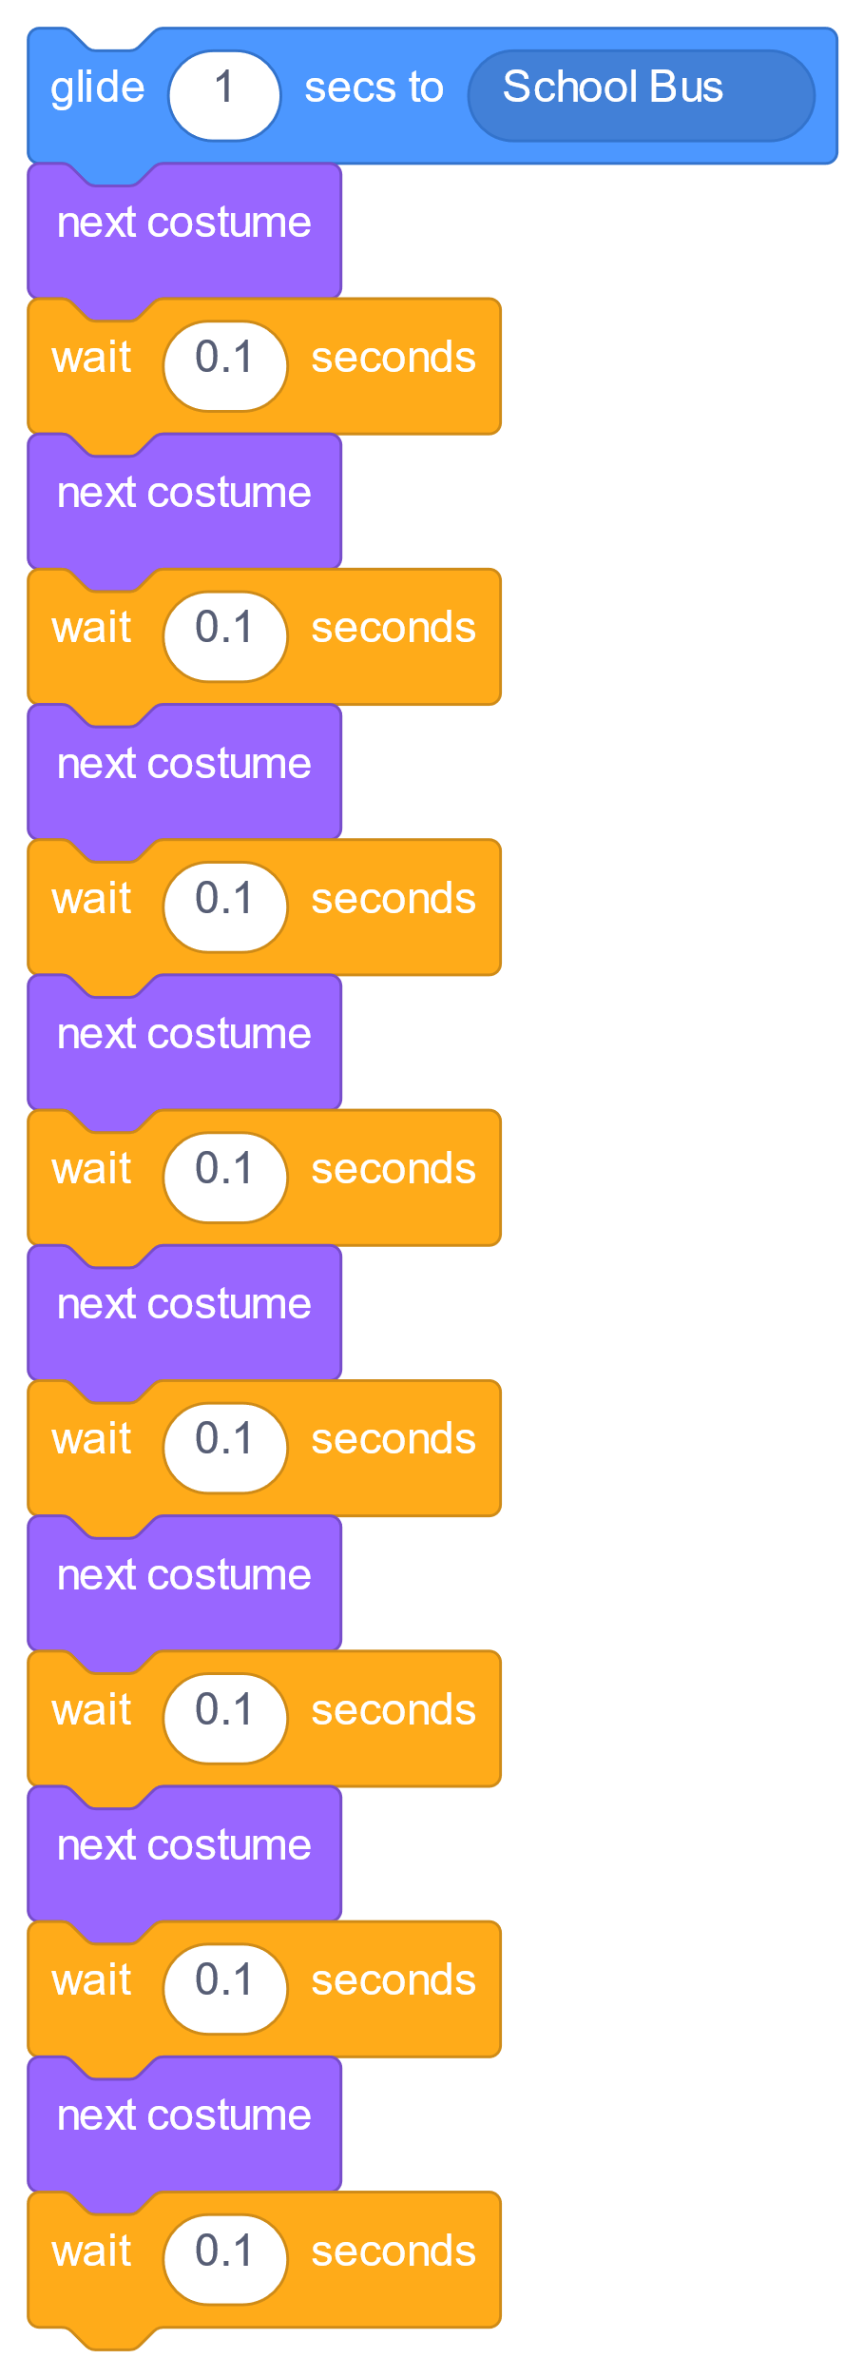
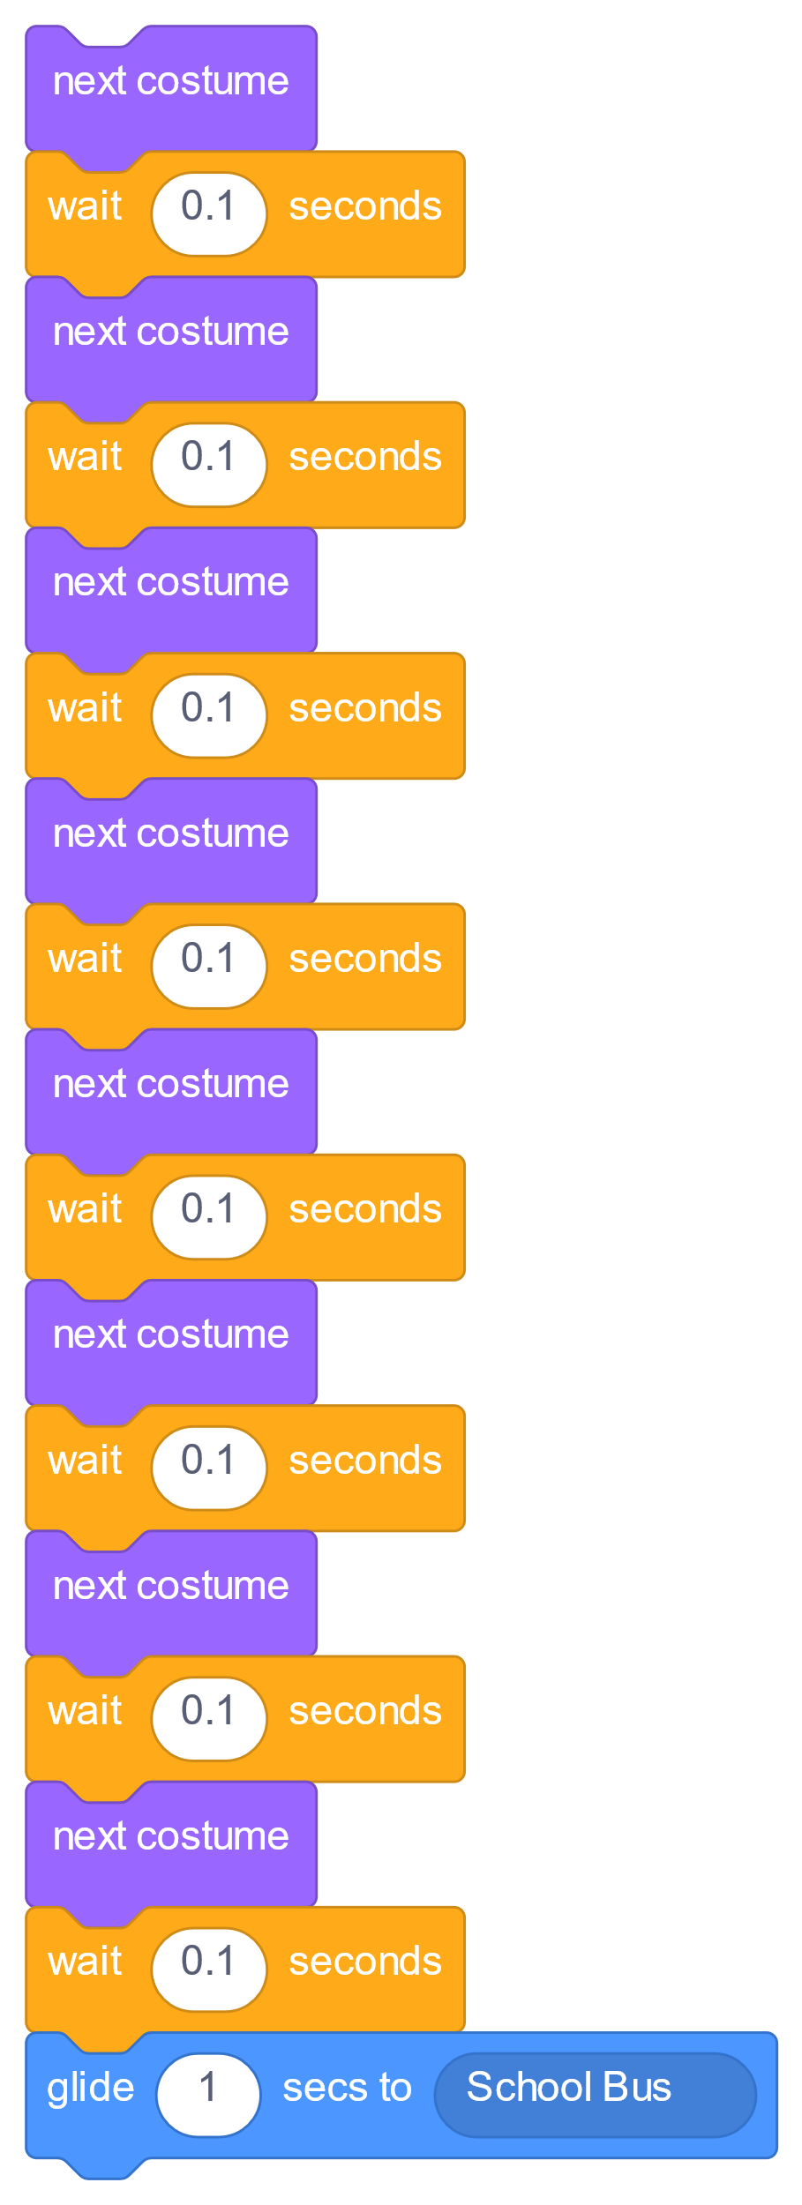
When to Glide?
Before or after switching costumes?

Slide 22
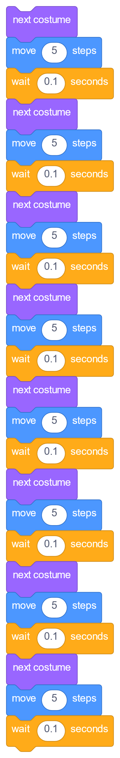
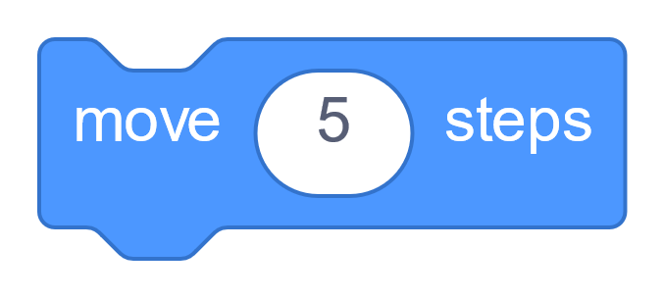
Move While Switching Costumes

Slide 23
Far Enough?
8 moves
Not at the bus yet!!!

Slide 24
Far Enough?
16 moves
Better, still not quite!!!

Slide 25
Add Even More Moves?
No! Long script with repetitive code is bad!

Slide 26



Loop

Slide 27
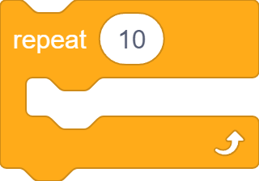

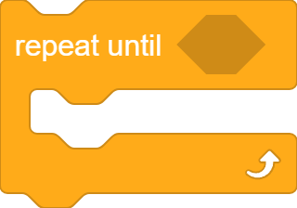
Loops in Scratch

Slide 28
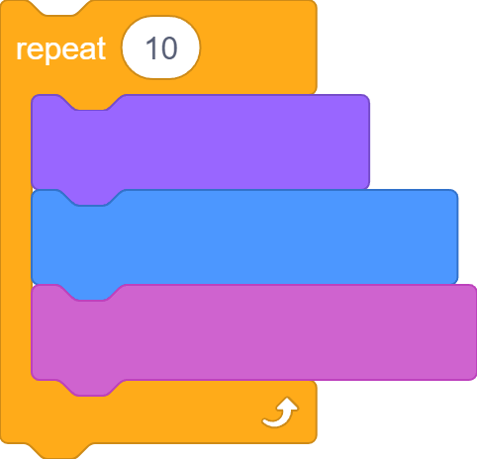
Repeat Block
Number of iterations
Code blocks to iterate

Slide 29
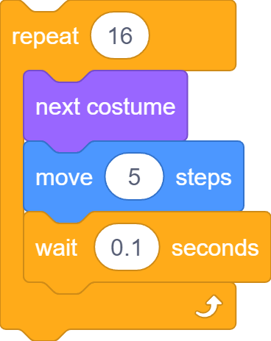
Repeat Block

Slide 30
Repeat Block

Slide 31




Show and Hide

Slide 32
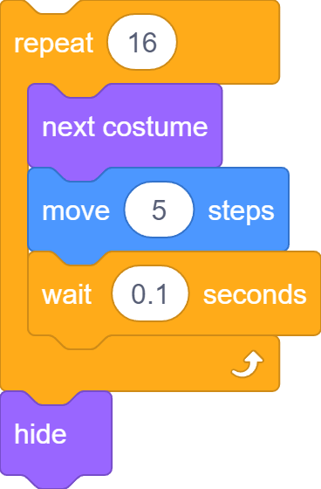
Get on the Bus

Slide 33
Problem
Bear is still hidden the next time round!

Slide 34
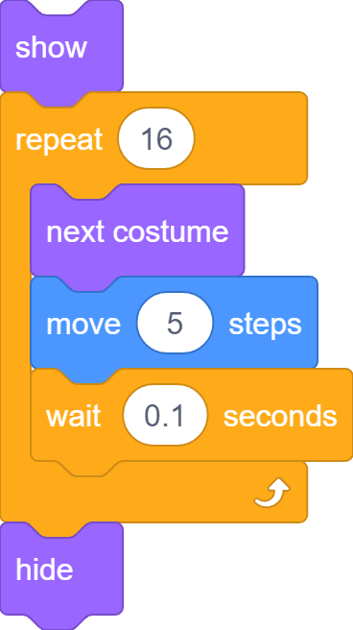
Show it!

Slide 35
Show and Hide

Slide 36
What we learnt…

Slide 37
Exercises
Have fun with some of the other effects
Try different sprites and backdrops
Say and think differently
Checkout costumes of other sprites
Invent your own way of communication!

Slide 38
Thank you and see you in the next lesson!

